Slide 1

Solving the Exam Struggle: Sorting Syllabus and Topics Made Easy
Are you struggling to manage your exam preparation? Feeling overwhelmed by the syllabus and unsure where to start?
DH
by DevilsGaming Hub

Slide 2

The Problem: Overwhelmed Students, Unorganized Exam Preparation
1
Massive Syllabus
2
Limited Time
3
Lack of Focus
The sheer volume of material can be daunting, making it difficult to prioritize what's important.
Balancing study time with other responsibilities can be challenging, leading to inefficient preparation.
Without a clear understanding of what's most critical, students may struggle to allocate study time effectively.

Slide 3

Introducing Our Solution: A Simplified Approach
Structure
Prioritization
Efficiency
Breaking down the syllabus into manageable chunks helps make the process less overwhelming.
Identifying key topics and concepts allows students to focus their efforts on what matters most.
Our approach helps students maximize their study time, leading to better performance.

Slide 4
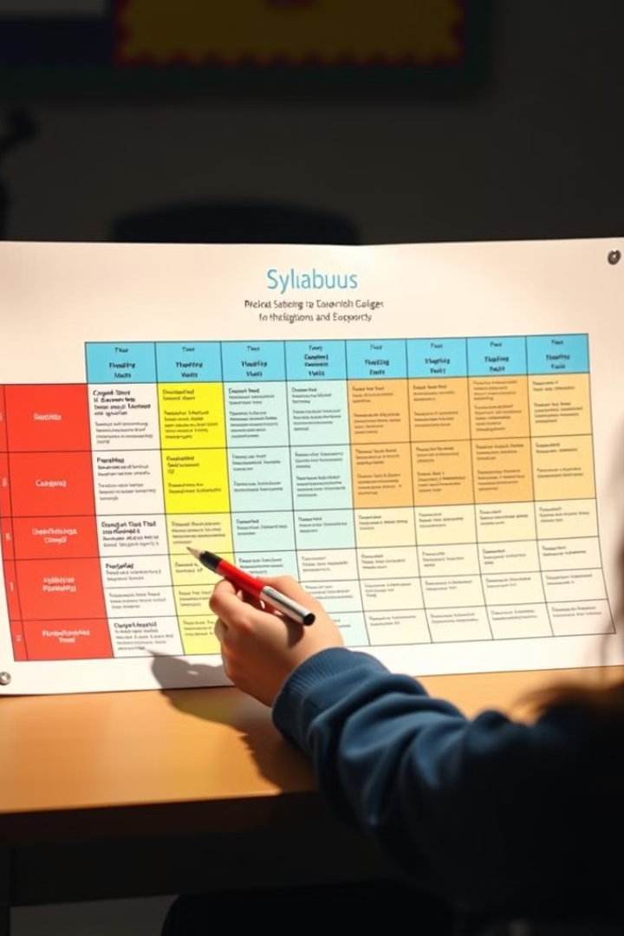
Step 1: Breaking Down the Syllabus
1
Identify Chapters
Start by listing all chapters and subtopics covered in the syllabus.
2
Group Related Topics
Organize chapters and subtopics into logical groups based on themes or concepts.
3
Create a Visual Outline
Use a flowchart or mind map to visually represent the structure of the syllabus.

Slide 5




Step 2: Identifying Key Topics and Priorities
Review Past Papers
Analyze past exam papers to identify recurring topics and themes.
Teacher's Emphasis
Pay attention to what your teacher emphasizes during lectures and discussions.
Textbook Importance
Identify chapters or sections that are heavily emphasized in the textbook.

Slide 6
Step 3: Developing Effective Study Strategies
Active Learning
Spaced Repetition
Seeking Help
Engaging with the material through summarizing, note-taking, and practice problems.
Revisiting material at increasing intervals to reinforce learning and prevent forgetting.
Don't hesitate to ask for help from teachers, peers, or online resources when needed.

Slide 7

Putting it All Together: A Streamlined Exam Preparation Process
1
Syllabus Breakdown
Divide the syllabus into manageable units and assign study time for each.
2
Topic Prioritization
Focus on high-priority topics, ensuring adequate coverage of important areas.
3
Strategic Studying
Employ effective study techniques to maximize learning and retention.
4
Regular Review
Regularly review material to reinforce learning and maintain momentum.

Slide 8




The Benefits: Reduced Stress, Improved Performance
Organized Study
A structured approach helps students manage their time effectively, reducing anxiety and stress.
Enhanced Learning
Focusing on key topics leads to better understanding and retention of important information.
Improved Results
Efficient preparation allows students to perform better on exams, leading to higher scores.

